Slide 1
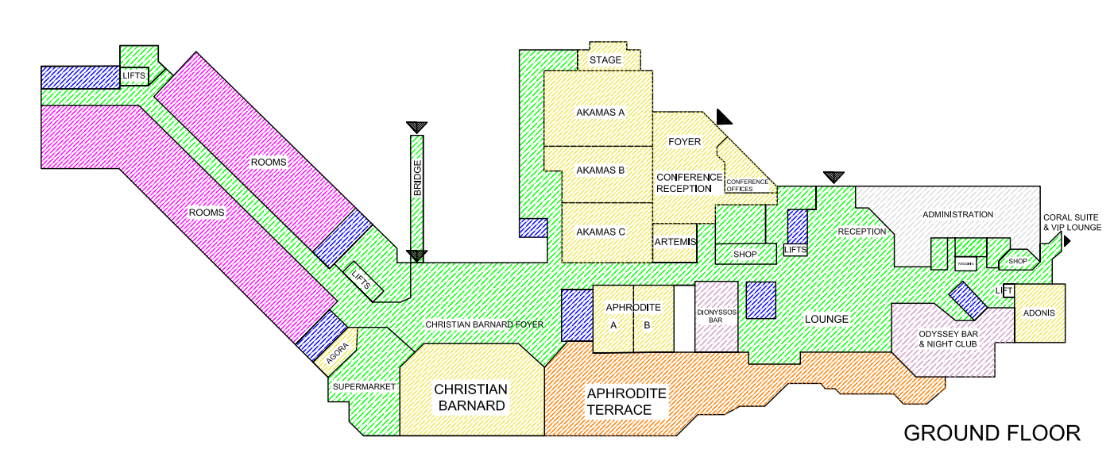
Registration & Poster session
Conference Room
Coffee Break

